Slide 1
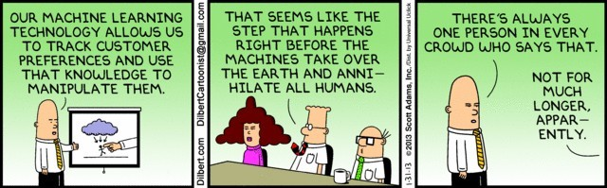
Cluster Analysis: Basic Concepts and Algorithms

Slide 2
Topics
Introduction
Types of Clustering
Types of Clusters
Clustering Algorithms
K-Means Clustering
Hierarchical Clustering
Density-based Clustering
Cluster Validation

Slide 3
What is Cluster Analysis?
Finding groups of objects such that the objects in a group will be similar (or related) to one another and different from (or unrelated to) the objects in other groups
Inter-cluster distances are maximized
Intra-cluster distances are minimized

Slide 4
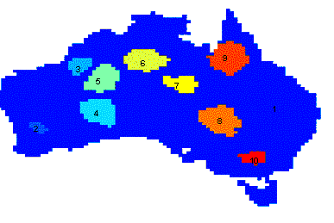
Applications of Cluster Analysis
 | Discovered Clusters | Industry Group
1 | Applied-Matl-DOWN,Bay-Network-Down,3-COM-DOWN, Cabletron-Sys-DOWN,CISCO-DOWN,HP-DOWN, DSC-Comm-DOWN,INTEL-DOWN,LSI-Logic-DOWN, Micron-Tech-DOWN,Texas-Inst-Down,Tellabs-Inc-Down, Natl-Semiconduct-DOWN,Oracl-DOWN,SGI-DOWN, Sun-DOWN | Technology1-DOWN
2 | Apple-Comp-DOWN,Autodesk-DOWN,DEC-DOWN, ADV-Micro-Device-DOWN,Andrew-Corp-DOWN, Computer-Assoc-DOWN,Circuit-City-DOWN, Compaq-DOWN, EMC-Corp-DOWN, Gen-Inst-DOWN, Motorola-DOWN,Microsoft-DOWN,Scientific-Atl-DOWN | Technology2-DOWN
3 | Fannie-Mae-DOWN,Fed-Home-Loan-DOWN, MBNA-Corp-DOWN,Morgan-Stanley-DOWN | Financial-DOWN
4 | Baker-Hughes-UP,Dresser-Inds-UP,Halliburton-HLD-UP, Louisiana-Land-UP,Phillips-Petro-UP,Unocal-UP, Schlumberger-UP | Oil-UP
Understanding
Group related documents for browsing, group genes and proteins that have
similar functionality, or group stocks with similar price fluctuations
Summarization
Reduce the size of large data sets
Clustering precipitation in Australia

Slide 5
What is not Cluster Analysis?
Supervised classification
Uses class label information
Simple segmentation
Dividing students into different registration groups alphabetically, by last name
Results of a query
Groupings are a result of an external specification
→ Clustering uses only the data

Slide 6
Similarity
How do we measure similarity/proximity/dissimilarity/distance?
Examples
Minkovsky distance: Manhattan distance, Euclidean
Distance, etc.
Jaccard index for binary data
Gower's distance for mixed data (ratio/interval and nominal)
Correlation coefficient as similarity between variables

Slide 7
Notion of a Cluster can be Ambiguous
How many clusters?

Slide 8
Notion of a Cluster can be Ambiguous
How many clusters?
Six Clusters
Two Clusters
Four Clusters

Slide 9
Topics
Introduction
Types of Clustering
Types of Clusters
Clustering Algorithms
K-Means Clustering
Hierarchical Clustering
Density-based Clustering
Cluster Validation

Slide 10
Types of Clusterings
A clustering is a set of clusters
Partitional Clustering
A division data objects into non-overlapping subsets (clusters) such that each data object is in exactly one subset
Hierarchical clustering
A set of nested clusters organized as a hierarchical tree

Slide 11
Partitional Clustering
Original Points
A Partitional Clustering

Slide 12
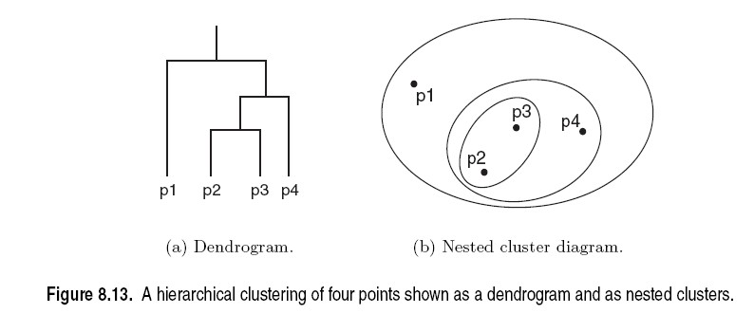
Hierarchical Clustering

Slide 13
Other Distinctions Between Sets of Clusters
Exclusive versus non-exclusive
In non-exclusive clusterings, points may belong to multiple clusters.
Fuzzy versus non-fuzzy
In fuzzy clustering, a point belongs to every cluster with some membership weight between 0 and 1
Membership weights must sum to 1
Probabilistic clustering has similar characteristics
Partial versus complete
In some cases, we only want to cluster some of the data
Heterogeneous versus homogeneous
Cluster of widely different sizes, shapes, and densities

Slide 14
Topics
Introduction
Types of Clustering
Types of Clusters
Clustering Algorithms
K-Means Clustering
Hierarchical Clustering
Density-based Clustering
Cluster Validation

Slide 15
Types of Clusters
Center-based clusters
Contiguous clusters
Density-based clusters
Conceptual clusters
Described by an Objective Function

Slide 16
Center-based Clusters
Not well separated (overlapping)
Well separated
Cluster Center
A cluster is a set of objects such that an object in a cluster is closer (more similar) to the “center” of a cluster, than to the center of any other cluster
The center of a cluster is often a centroid, the average of all the points in the cluster, or a medoid, the most “representative” point of a cluster

Slide 17
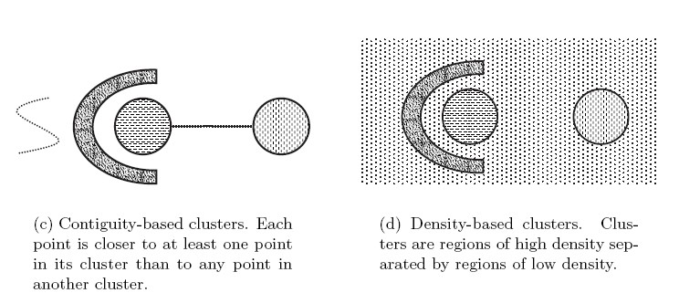
Contiguous and Density-based Clusters
High density

Slide 18
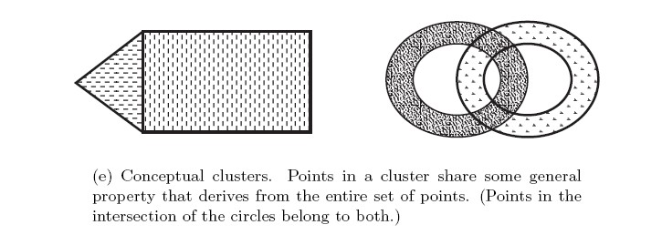
Conceptual Clusters
Conceptual clusters are hard to detect since they are often not:
●
Center-based Contiguity-based Density-based
●
●

Slide 19
Topics
Introduction
Types of Clustering
Types of Clusters
Objective Functions
Clustering Algorithms
K-Means Clustering
Hierarchical Clustering
Density-based Clustering
Cluster Validation

Slide 20
Objective Functions
The best clustering minimizes or maximizes an objective function.
Example: Minimize the Sum of Squared Errors
K
2
SSE =
∑ ∑
‖x −m ‖
i
i= 1 x ∈C_{i}
- x is a data point in cluster C_{i ,} m_{i} is the center for cluster C_{i} as the mean of all points in the cluster and ||.|| is the L2 norm (= Euclidean distance).
Problem: Enumerate all possible ways of dividing the points into clusters and evaluate the `goodness' of each potential set of clusters by using the given objective function. (NP Hard)

Slide 21
Objective Functions
Global objective function
Typically used in partitional clustering (k-means uses SSE)
Mixture Models assume that the data is a ‘mixture' of a number of parametric statistical distributions (e.g., a mixture of Gaussians).
Local objective function
Hierarchical clustering algorithms typically have local objectives
Density-based clustering is based on local density estimates
Graph based approaches. Graph partitioning and shared nearest neighbors
We will talk about the objective functions when we talk about individual clustering algorithms.

Slide 22
Topics
Introduction
Types of Clustering
Types of Clusters
Clustering Algorithms
K-Means Clustering
Hierarchical Clustering
Density-based Clustering
Cluster Validation

Slide 23
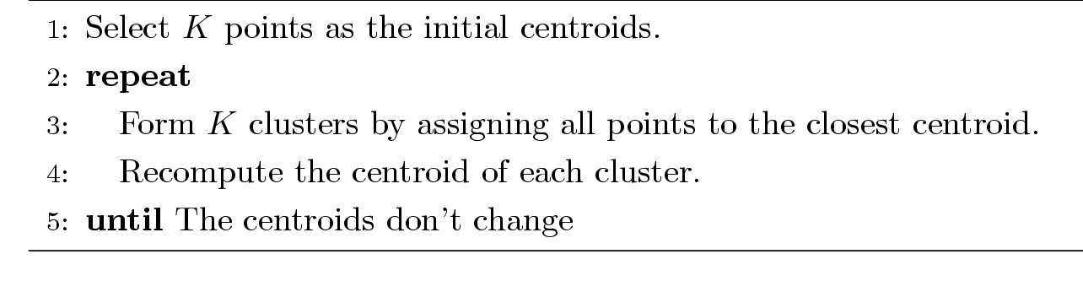
K-means Clustering
Partitional clustering approach
Each cluster is associated with a centroid (center point)
Each point is assigned to the cluster with the closest centroid
Number of clusters, K, must be specified
The basic algorithm is very simple:

Slide 24
K-means Clustering – Details
Initial centroids are often chosen randomly.
Clusters produced vary from one run to another.
The centroid is the mean of the points in the cluster.
‘Closeness’ is measured by Euclidean distance
K-means will converge (points stop changing assignment) typically in the first few iterations.
Often the stopping condition is changed to ‘Until
relatively few points change clusters’
Complexity is O( n * K * I * d )
n = number of points, K = number of clusters,
I = number of iterations, d = number of attributes

Slide 25
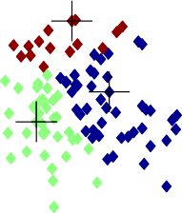
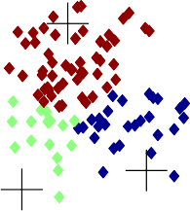
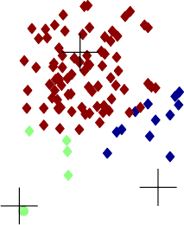



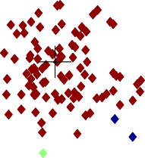
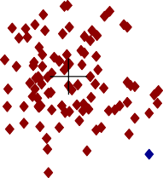
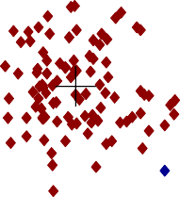



K-Means Example
Iteration1
Iteration2
Iteration3
3
3
3
2.5
2.5
2.5
2
2
2
y
1.5
y
1.5
y
1.5
1
1
1
0.5
0.5
0.5
0
0
0
-2
-1.5
-1 -.50 0
x
0.5
1
1.5
2
-2
-1.5
-1 -.50 0
x
0.5
1
1.5
2
-2
-1.5
-1 -.50 0
x
0.5
1
1.5
2
Iteration4
Iteration5
Iteration6
3
3
3
2.5
2.5
2.5
2
2
2
y
1.5
y
1.5
y
1.5
1
1
1
0.5
0.5
0.5
0
0
0
-2
-1.5
-1 -.50 0
x
0.5
1
1.5
2
-2
-1.5
-1 -0.5 0
x
0.5
1
1.5
2
-2
-1.5
-1 -.50 0
x
0.5
1
1.5
2

Slide 26
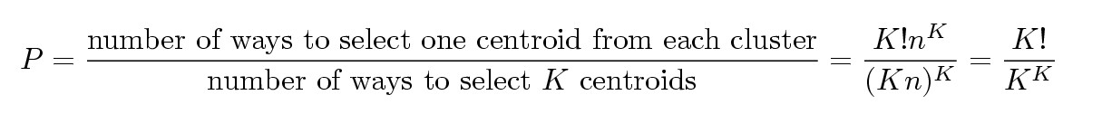
Problems with Selecting Initial Points
If there are K ‘real’ clusters then the chance of selecting one centroid from each cluster is small.
Chance is relatively small when K is large
If clusters are the same size, n, then
For example, if K = 10, then probability = 10!/1010 = 0.00036
Sometimes the initial centroids will readjust themselves in ‘right’ way, and sometimes they don’t
Consider an example of five pairs of clusters

Slide 27
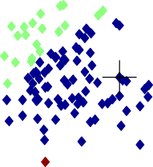
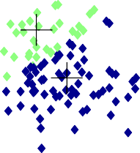


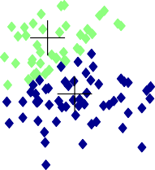
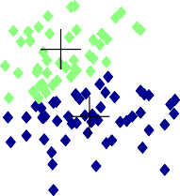




Importance of Choosing Initial Centroids …
Iteration1
Iteration2
3
3
2.5
2.5
2
2
y
1.5
y
1.5
1
1
0.5
0.5
0
0
-2 -1.5
-1 -.50
0
x
0.5
1
1.5
2
-2
-1.5
-1 -.50
0
x
0.5
1
1.5
2
Iteration3
2
Iteration4
Iteration5
3
3
3
2.5
2.5
2.5
2
2
2
y
1.5
y
1.5
y
1.5
1
1
1
0.5
0.5
0.5
0
0
0
-2 -1.5 -1 -0.5 0
x
0.5
1
1.5
-2
-1.5 -1 -.50 0
x
0.5
1
1.5
2
-2
-1.5 -1 -.50 0
x
0.5
1
1.5
2

Slide 28
Solutions to Initial Centroids Problem
Multiple runs
Sample and use hierarchical clustering to determine initial centroids
Select more than k initial centroids and then select among these initial centroids (Select most widely separated)

Slide 29
Evaluating K-means Clusters
Most common measure is Sum of Squared Error (SSE)
- For each point, the error is the distance to the nearest cluster center
K
2
SSE =
∑ ∑
‖x −m ‖
i
i= 1 x ∈C_{i}
x is a data point in cluster C_{i ,} m_{i} is the center for cluster C_{i} as the
mean of all points in the cluster and ||.|| is the L2 norm (= Euclidean distance).
Given two clusterings, we can choose the one with the smallest
error
Only compare clusterings with the same K! One easy way to reduce SSE is to increase K, the number of clusters
K-Means is a heuristic to minimize SSE.

Slide 30
Pre-processing and Post-processing
Pre-processing
Normalize the data (e.g., scale to unit standard
deviation)
Eliminate outliers
Post-processing
Eliminate small clusters that may represent
outliers
Split ‘loose’ clusters, i.e., clusters with relatively
high SSE
Merge clusters that are ‘close’ and that have
relatively low SSE

Slide 31
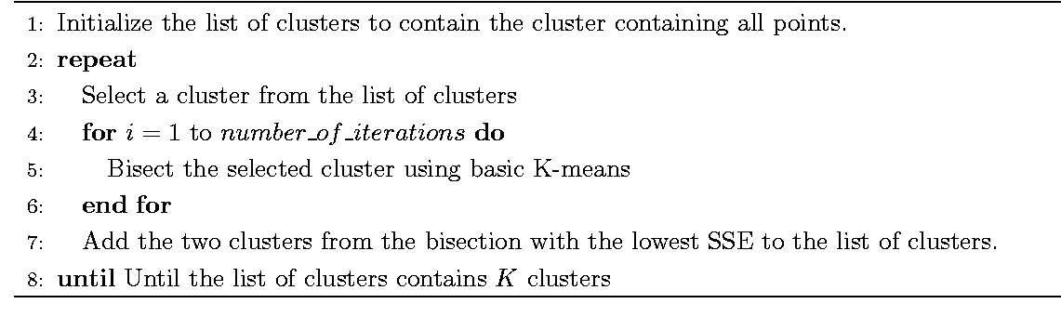
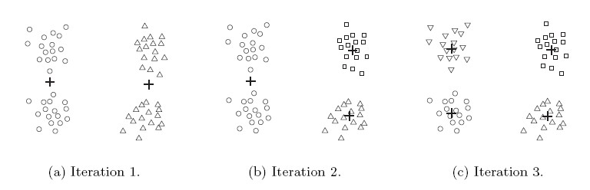
Bisecting K-means
Variant of K-means that can produce a partitional or a hierarchical clustering

Slide 32
Limitations of K-means
K-means has problems when clusters are of differing
Sizes
Densities
Non-globular shapes
K-means has problems when the data contains outliers.

Slide 33
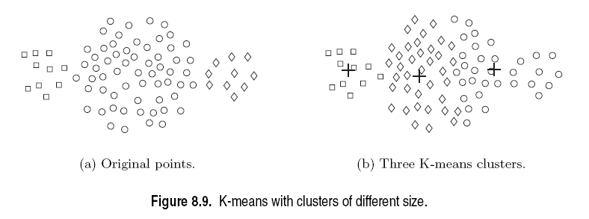
Limitations of K-means: Differing Sizes

Slide 34
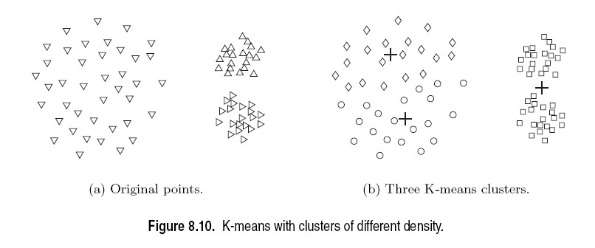
Limitations of K-means: Differing Density

Slide 35
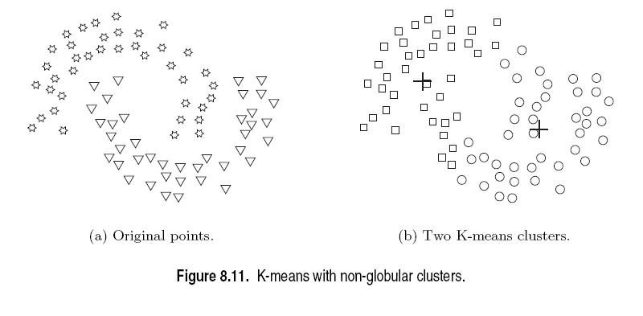
Limitations of K-means: Non-globular Shapes

Slide 36
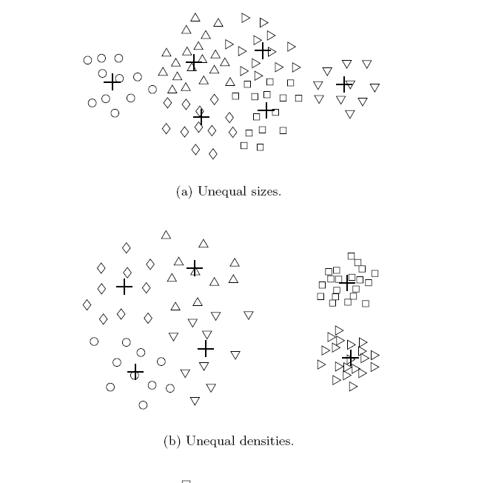
Overcoming K-means Limitations
Use a larger number of clusters
Several clusters represent a true cluster

Slide 37
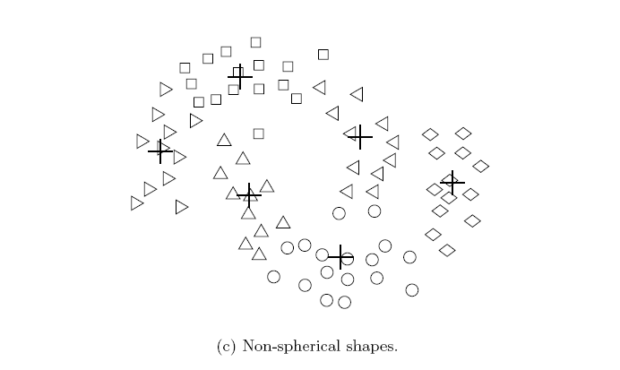
Overcoming K-means Limitations
Use a larger number of clusters
Several clusters represent a true cluster

Slide 38
Topics
Introduction
Types of Clustering
Types of Clusters
Clustering Algorithms
K-Means Clustering
Hierarchical Clustering
Density-based Clustering
Cluster Validation

Slide 39
Hierarchical Clustering
Produces a set of nested clusters organized as a hierarchical tree
Can be visualized as a dendrogram
- A tree like diagram that records the sequences
of merges or splits
distance
6
5
0.2
4
3
2
4
0.15
5
2
0.1
1
0.05
3
1
0
1
3
2
5
4
6

Slide 40
Strengths of Hierarchical Clustering
You do not have to assume any particular number of clusters
Any desired number of clusters can be
obtained by ‘cutting’ the dendogram at the proper level
They may correspond to meaningful taxonomies
Example in biological sciences (e.g., animal kingdom, phylogeny reconstruction, …)

Slide 41
Hierarchical Clustering
Two main types of hierarchical clustering
Agglomerative:
Start with the points as individual clusters
At each step, merge the closest pair of clusters until only one cluster (or k clusters) left
Divisive:
Start with one, all-inclusive cluster
At each step, split a cluster until each cluster contains a point (or there are k clusters)
Traditional hierarchical algorithms
use a similarity or distance matrix
merge or split one cluster at a time

Slide 42
Agglomerative Clustering Algorithm
More popular hierarchical clustering technique
Basic algorithm is straightforward
1.Compute the proximity matrix 2.Let each data point be a cluster 3.Repeat
4.
5.
Merge the two closest clusters Update the proximity matrix
6.Until only a single cluster remains
Key operation is the computation of the proximity of two clusters → Different approaches to defining the distance between clusters distinguish the different algorithms

Slide 43
Starting Situation
Start with clusters of individual points and a proximity matrix
 | p1 | p2 | p3 | p4 | p5 | .
p1
p2
p3
p4
p5
.
. .
.
.
Proximity Matrix
...

Slide 44
Intermediate Situation
After some merging steps, we have some clusters
 | C1 | C2 | C3 | C4 | C5
C1
C2
C3
C4
C5
C3
C4
Proximity Matrix
C1
C2
C5
...
C2
C5
C3

Slide 45
Intermediate Situation
We want to merge the two closest clusters (C2 and C5) and update the proximity matrix.
 | C1 | C2 | C3 | C4 | C5
C1
C2
C3
C4
C5
C3
C4
Proximity Matrix
C1
C2
C5
...
C2 C5
C3

Slide 46
After Merging
The question is “How do we update the proximity matrix?”
C2
U
 | C1 | C5 | C3 | C4
C1 |  | ?
C5 | ? | ? | ? | ?
C3 |  | ?
C4 |  | ?
C2 U
C3
C4
Proximity Matrix
C1
C2 U C5
...
C2 C5
C3

Slide 47
How to Define Inter-Cluster Similarity
 | p1 | p2 | p3 | p4 | p5 | .
p1
p2
p3
p4
p5
.
. .
Similarity?
MIN
MAX
Group Average
.
.
Proximity Matrix
Distance Between Centroids
Other methods driven by an objective function
- Ward’s Method uses squared error

Slide 48
How to Define Inter-Cluster Similarity
 | p1 | p2 | p3 | p4 | p5 | .
p1
p2
p3
p4
p5
.
. .
MIN (Single Link)
MAX
Group Average
.
.
Proximity Matrix
Distance Between Centroids
Other methods driven by an objective function
- Ward’s Method uses squared error

Slide 49
How to Define Inter-Cluster Similarity
 | p1 | p2 | p3 | p4 | p5 | .
p1
p2
p3
p4
p5
.
. .
MIN
MAX (Complete Link)
Group Average
.
.
Proximity Matrix
Distance Between Centroids
Other methods driven by an objective function
- Ward’s Method uses squared error

Slide 50
How to Define Inter-Cluster Similarity
 | p1 | p2 | p3 | p4 | p5 | .
p1
p2
p3
p4
p5
.
. .
MIN
MAX
Group Average (Average Link)
.
.
Proximity Matrix
Distance Between Centroids
Other methods driven by an objective function
- Ward’s Method uses squared error

Slide 51
How to Define Inter-Cluster Similarity
 | p1 | p2 | p3 | p4 | p5 | .
p1
p2
p3
p4
p5
.
. .
×
×
MIN
MAX
Group Average
.
.
Proximity Matrix
Distance Between Centroids
Other methods driven by an objective function
- Ward’s Method uses squared error

Slide 52
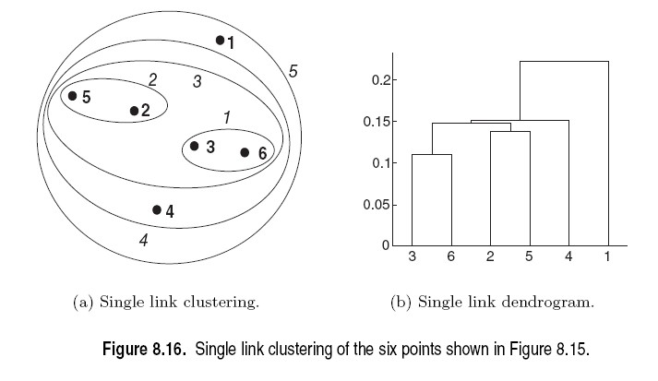
Single Link
Advantage: Non-spherical, non-convex clusters
Problem: Chaining

Slide 53
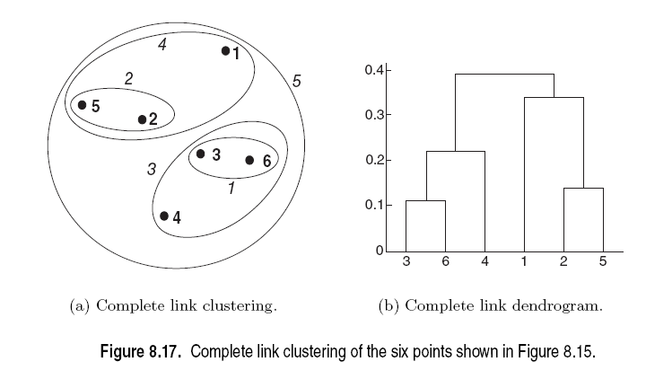
Complete Link
Advantage: more robust against noise (no chaining)
Problem: Tends to break large clusters, Biased towards globular clusters

Slide 54
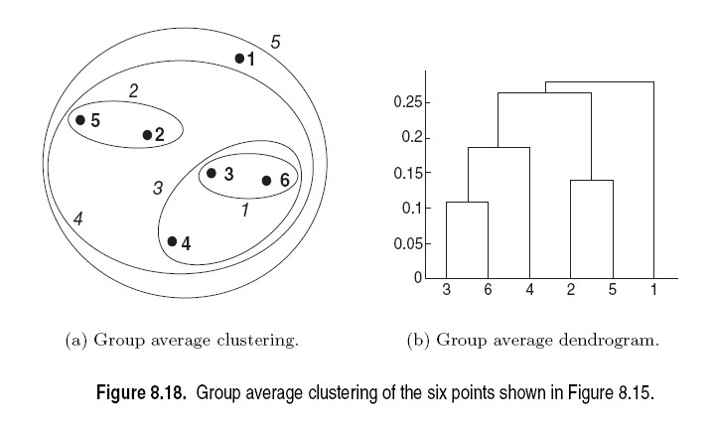
Average Link
Compromise between Single and Complete Link

Slide 55
Cluster Similarity: Ward’s Method
Similarity of two clusters is based on the increase in squared error when two clusters are merged
Less susceptible to noise and outliers
Biased towards globular clusters
Hierarchical analogue of K-means
- Can be used to initialize K-means

Slide 56
Hierarchical Clustering: Complexity
O(N²) space since it uses the proximity matrix.
N is the number of points.
O(N³) time in many cases
There are N steps and at each step the
proximity matrix of size N² must be updated and
searched
Complexity can be reduced to O(N² log(N)) time
for some approaches

Slide 57
Hierarchical Clustering: Limitations
Greedy: Once a decision is made to combine two clusters, it cannot be undone
No global objective function is directly minimized
Different schemes have problems with one or more of the following:
Sensitivity to noise and outliers
Difficulty handling different sized clusters and
convex shapes
Chaining, breaking large clusters

Slide 58
Topics
Introduction
Types of Clustering
Types of Clusters
Clustering Algorithms
K-Means Clustering
Hierarchical Clustering
Density-based Clustering
Cluster Validation

Slide 59
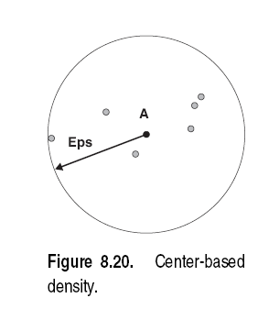
DBSCAN
Density = 7 points
Density = number of points within a specified radius (Eps)

Slide 60
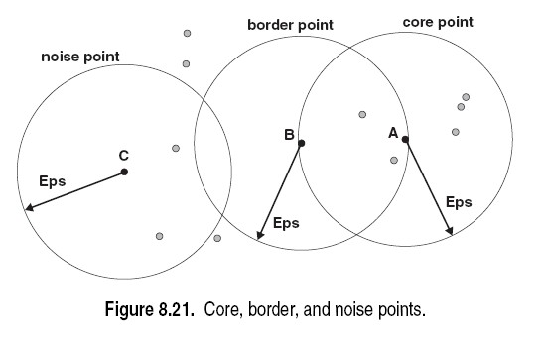
DBSCAN
MinPts = 4
A point is a core point if it has more than a specified number of points (MinPts) within Eps. These are points that are at the interior of a cluster
A border point has fewer than MinPts within Eps, but is in the neighborhood of a core point
A noise point is any point that is not a core point or a border point.

Slide 61
DBSCAN Algorithm
DBSCAN(D, eps, MinPts)
C = 0
for each unvisited point P in dataset D mark P as visited
NeighborPts = regionQuery(P, eps) if sizeof(NeighborPts) < MinPts
mark P as NOISE else
C = next cluster
expandCluster(P, NeighborPts, C, eps, MinPts)
expandCluster(P, NeighborPts, C, eps, MinPts) add P to cluster C
for each point P' in NeighborPts if P' is not visited
mark P' as visited
NeighborPts' = regionQuery(P', eps) if sizeof(NeighborPts') >= MinPts
NeighborPts = NeighborPts joined with NeighborPts' if P' is not yet member of any cluster
add P' to cluster C

Slide 62
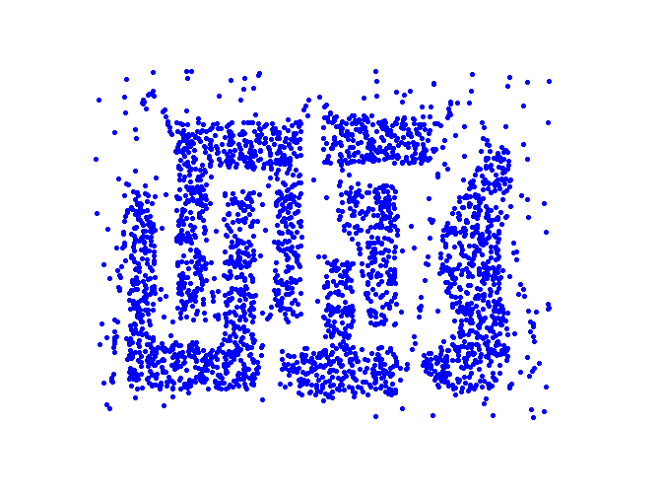
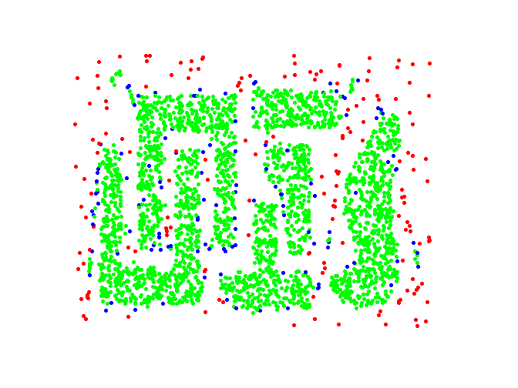
DBSCAN: Core, Border and Noise Points
Original Points
Point types: core, border and noise
Eps = 10, MinPts = 4

Slide 63
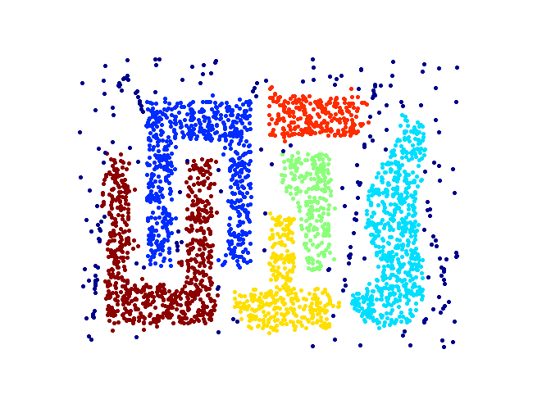
DBSCAN: Determine Clusters
Point types: core, border and noise
Clusters
Resistant to Noise
Can handle clusters of different shapes and sizes
Eps and MinPts depend on each other and can be hard to specify

Slide 64
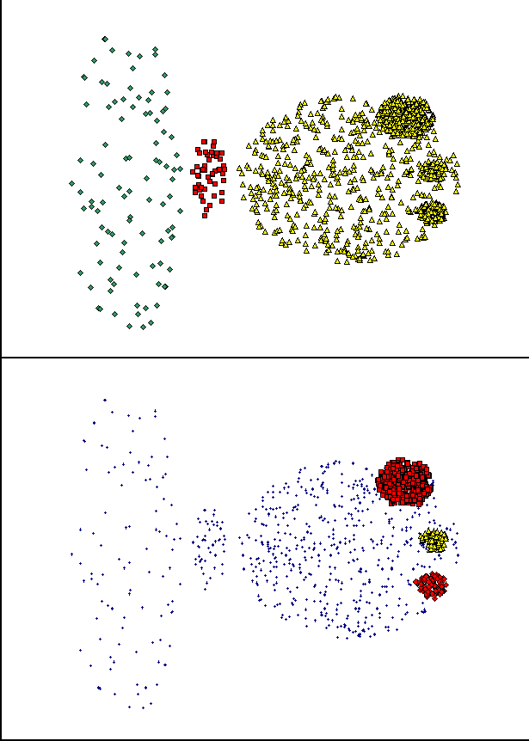
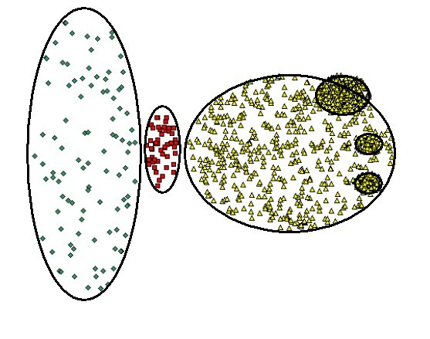
When DBSCAN Does NOT Work Well
(MinPts=4, Eps=9.75).
Original Points
Varying densities
High-dimensional data
(MinPts=4, Eps=9.92)

Slide 65
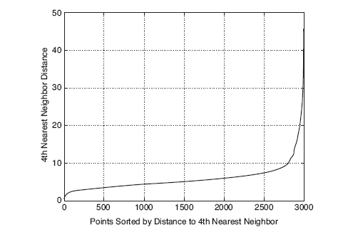
DBSCAN: Determining EPS and MinPts
Idea is that for points in a cluster, their kth nearest neighbors are at roughly the same distance
Noise points have the kth nearest neighbor at farther distance
So, plot sorted distance of every point to its kth nearest neighbor
MinPts = k
Eps

Slide 66
Some Other Clustering Algorithms
Center-based Clustering
Fuzzy c-means
PAM (Partitioning Around Medoids)
Mixture Models
Expectation-maximization (EM) algorithm
Hierarchical
CURE (Clustering Using Representatives): shrinks points toward center
BIRCH (balanced iterative reducing and clustering using hierarchies)
Graph-based Clustering
Graph partitioning on a sparsified proximity graph
Shared nearest-neighhbor (SNN graph)
Subspace Clustering
Data Stream Clustering

Slide 67
Topics
Introduction
Types of Clustering
Types of Clusters
Clustering Algorithms
K-Means Clustering
Hierarchical Clustering
Density-based Clustering
Cluster Validation

Slide 68
Cluster Validity
For supervised classification (= we have a class label) we
have a variety of measures to evaluate how good our model is: Accuracy, precision, recall
For cluster analysis (=unsupervised learning), the analogous question is:
How to evaluate the “goodness” of the resulting clusters?

Slide 69





Clusters found in Random Data (Overfitting)
1
1
0.9
0.9
0.8
0.8
Random Points
0.7
0.7
DBSCAN
0.6
0.6
y
0.5
y
0.5
0.4
0.4
0.3
0.3
0.2
0.2
0.1
0.1
0
0
0
0.2
0.4
0.6
0.8
1
0
0.2
0.4
0.6
0.8
1
x
x
1
1
0.9
0.9
K-means
0.8
0.8
Complete Link
0.7
0.7
0.6
0.6
y
0.5
y
0.5
0.4
0.4
0.3
0.3
0.2
0.2
0.1
0.1
0
0
0
0.2
0.4
0.6
0.8
1
0
0.2
0.4
0.6
0.8
1
x x
If you tell a clustering algorithm to find clusters then it will!

Slide 70
Different Aspects of Cluster Validation
Determining the clustering tendency of a set of data, i.e., distinguishing whether non-random structure actually exists in the data (e.g., to avoid overfitting).
External Validation: Compare the results of a cluster analysis to externally known class labels (ground truth).
Internal Validation: Evaluating how well the results of a cluster analysis fit the data without reference to external information.
Compare clusterings to determine which is better.
Determining the ‘correct’ number of clusters.
For 2, 3, and 4, we can further distinguish whether we want to evaluate the entire clustering or just individual clusters.

Slide 71
Measures of Cluster Validity
Numerical measures that are applied to judge various aspects of cluster validity, are classified into the following three types.
External Index: Used to measure the extent to which cluster labels match externally supplied class labels.
Entropy, Purity, Rand index
Internal Index: Used to measure the goodness of a clustering structure without respect to external information.
Sum of Squared Error (SSE), Silhouette coefficient
Relative Index: Used to compare two different clusterings or clusters.
Often an external or internal index is used for this function, e.g., SSE or entropy

Slide 72
Measuring Cluster Validity Via Correlation
Two matrices
Proximity Matrix
“Incidence” Matrix
One row and one column for each data point
An entry is 1 if the associated pair of points belong to the same cluster
An entry is 0 if the associated pair of points belongs to different clusters
Compute the correlation between the two matrices
Since the matrices are symmetric, only the correlation
between
n(n-1) / 2 entries needs to be calculated.
High correlation indicates that points that belong to the same cluster are close to each other.
Not a good measure for some density or contiguity based clusters (e.g., single link HC).

Slide 73

Measuring Cluster Validity Via Correlation
Correlation of incidence and proximity matrices for the K-means clusterings of the following two data sets.
1
1
0.9
0.9
0.8
0.8
0.7
0.7
0.6
0.6
y
0.5
y
0.5
0.4
0.4
0.3
0.3
0.2
0.2
0.1
0.1
0
0
0
0.2
0.4
x
0.6
0.8
1
0
0.2
0.4 0.6
x
0.8
1
Corr = -0.9235
Corr = -0.5810
Note: Correlation is negative between distance matrix and incidence matrix

Slide 74
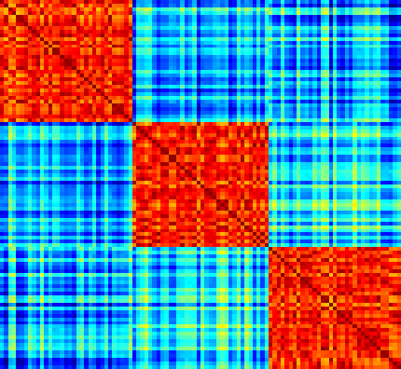
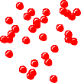
Using Similarity Matrix for Cluster Validation
Order the similarity matrix with respect to cluster labels and inspect visually.
1
1
0.9
10
0.9
0.8
20
0.8
0.7
30
0.7
0.6
Points
40
0.6
y
0.5
50
0.5
0.4
60
0.4
0.3
70
0.3
0.2
80
0.2
0.1
90
0.1
0
100
20
40
60
80
0
0
0.2
0.4
0.6
0.8
1
Points
¹⁰⁰Similarity
x

Slide 75
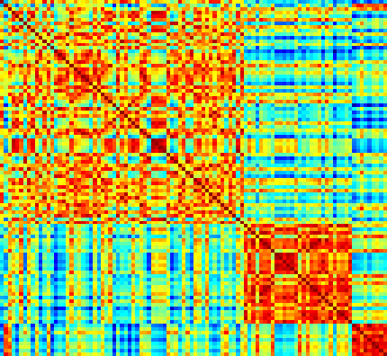
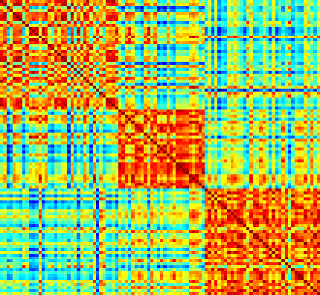
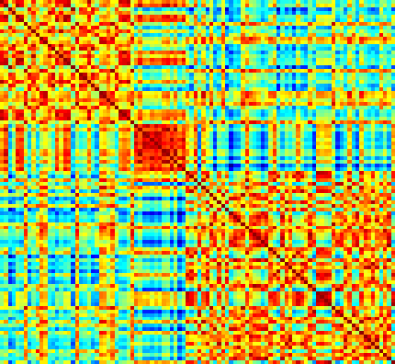
Using Similarity Matrix for Cluster Validation
Clusters in random data are not so crisp
1
DBSCAN
1
0.9
10
0.9
0.8
20
0.8
0.7
30
0.7
0.6
Points
40
0.6
y
0.5
50
0.5
0.4
60
0.4
0.3
70
0.3
0.2
80
0.2
0.1
90
0.1
0
100
20 40 60 80
Ponsti
0
0
0.2
0.4
0.6
0.8
1
¹⁰⁰Similarity
 | x
 |  |  |  | 1
10 | k-means |  |  | 0.9 | ¹⁰ Complete L. HC
20 |  |  |  | 0.8 | 20
30 |  |  |  | 0.7 | 30
40 |  |  |  | 0.6 | 40
50 |  |  |  | 0.5 | 50
60 |  |  |  | 0.4 | 60
70 |  |  |  | 0.3 | 70
80 |  |  |  | 0.2 | 80
90 |  |  |  | 0.1 | 90
100 |  |  |  | 0 | 100
1
09.
08.
07.
06.
05.
04.
03.
02.
01.
Points
Points
20
40
60
80
¹⁰⁰Similarity
20
40
60
80
0
Points
Points
¹⁰⁰Similarity

Slide 76
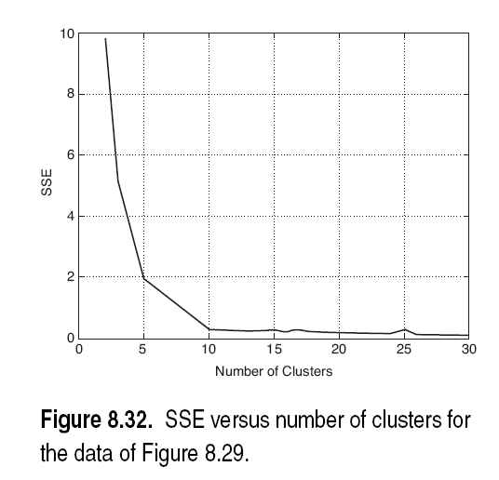
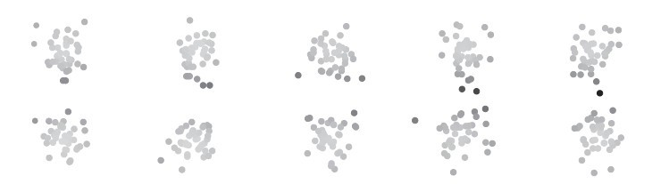
Internal Measures: SSE
SSE is good for comparing two clusterings or two clusters
(average SSE).
K
∑ ∑
SSE =
‖x −m ‖
2
i
i= 1 x ∈C_{i}
Can also be used to estimate the number of clusters
10 clusters
Look for the knee

Slide 77
Internal Measures: Cohesion and Separation
Cluster Cohesion: Measures how closely related are objects in a cluster
- Example: Within cluster sum of squares (WSS=SSE)
2
WSS=
∑ ∑
‖x −m ‖
i
i
x∈ C_{i}
Cluster Separation: Measure how distinct or well- separated a cluster is from other clusters
- Example: Between cluster sum of squares (BSS)
2
BSS =
∑
|C |‖m−m ‖
i
i
i
Where |C_{i}| is the size of cluster i
Total sum of squares
TSS =WSS+ BSS

Slide 78
Internal Measures: Cohesion and Separation
Example: TSS = BSS + WSS = constant for a given data set
m
×
1 2 3 4
WSS=( 1−3)²+( 2−3 )² +( 4−3 )² +(5−3 )²=10
BSS=4×( 3−3 )² =0
Total =10 +0=10
K=1 cluster:
5
K=2 clusters:
× ×
1
m₁ 2 3 4 m₂
5
WSS=( 1−1. 5)²+( 2−1. 5 )² +( 4 −4 .5 )² +(5−4 .5 )² =1
BSS=2×( 3−1 .5 )² +2×( 4 .5−3 )²=9
Total =1+9=10

Slide 79
Internal Measures: Cohesion and Separation
A proximity graph based approach can also be used for cohesion and separation.
–
–
Cluster cohesion is the sum of the weight of all links within a cluster.
Cluster separation is the sum of the weights between nodes in the cluster and nodes outside the cluster.
cohesion
separation

Slide 80

Internal Measures: Silhouette Coefficient
Silhouette Coefficient combine ideas of both cohesion and separation, but for individual points. For an individual point i:
Calculate a(i) = average dissimilarity of i to all other points in its cluster
Calculate b(i) = lowest average dissimilarity of i to any other)
a(i)
i
b(i)
Cohersion
Separation
- The closer to 1 the better.
Can calculate the Average Silhouette width for a cluster or a clustering

Slide 81
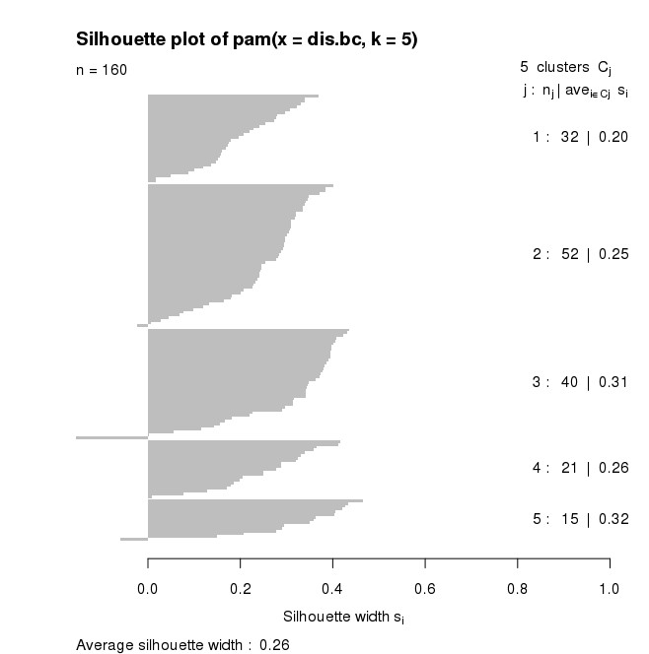
Internal Measures: Silhouette Plot

Slide 82
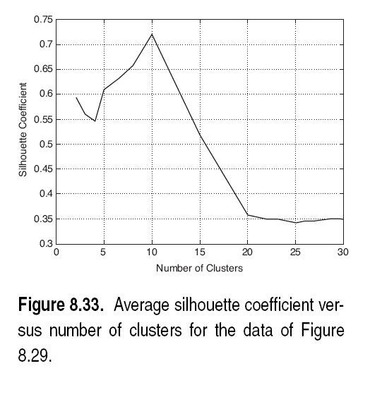
Internal Measures: Choosing k with Silhouette

Slide 83
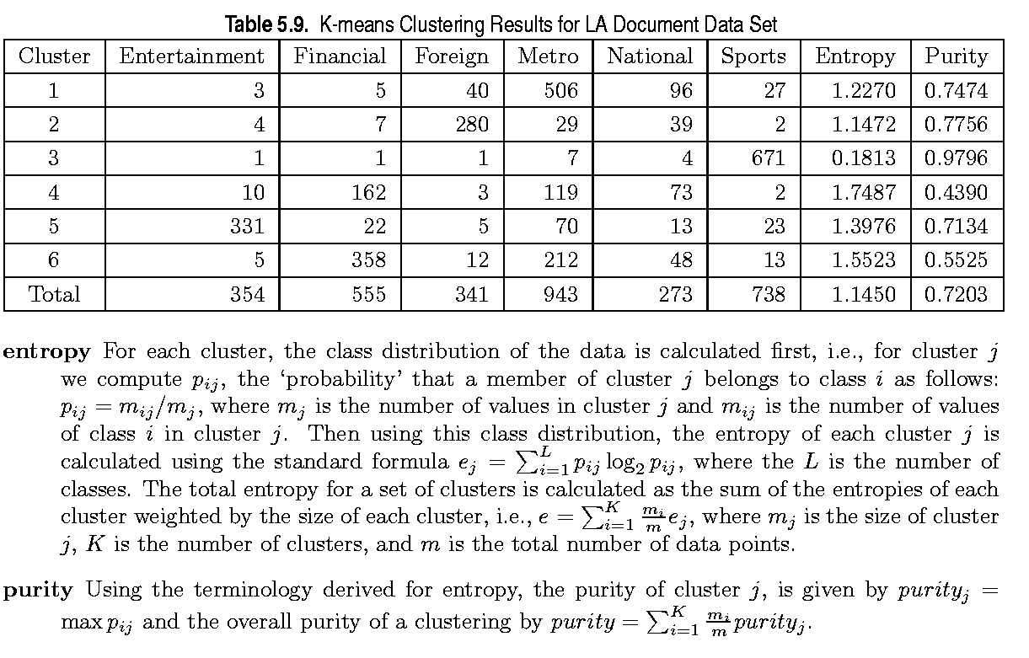
External Measures of Cluster Validity: Entropy and Purity
Other measures: Precision, Recall, F-measure, Rand, Adj. Rand

Slide 84
Final Comment on Cluster Validity
“The validation of clustering structures is the most difficult and frustrating part of cluster analysis.
Without a strong effort in this direction, cluster analysis will remain a black art accessible only to those true believers who have experience and great courage.”
Algorithms for Clustering Data, Jain and Dubes

